Slide 1
Improving the Odds of Your Agile Transformation
With 3 Simple Tricks
Notes:
Hello! Thank you all for taking the time to join me today!
My name is Jeremy Jarrell, and I want to talk to you about Improving the Odds of Your Agile Transformation.

Slide 2

Who Am I?
Jeremy Jarrell
Agile Coach
Software Engineer
Pluralsight Author
Notes:
Before we get started, just a bit about me:
I’m an agile coach, software engineer, and Pluralsight author.
And I’ve been luck enough to be involved in many agile transformations both as a team member and advisor to other teams
So I’ve had the opportunity to see first hand a lot of teams succeed with their agile transformation, and unfortunately some teams fail

Slide 3

No Perfect Recipe
Notes:
One thing I’ve noticed along the way is that there’s no perfect recipe for creating a high performing agile team since every organization and culture is different.
But
Commonalities between the teams that succeeded and those that didn’t
Your situation is unique, but following those practices improves your odds

Slide 4


3 Practices of Successful Teams
Notes:
So what are the practices?
There are lots, but there are 3 specific ones that I’d like to share with you today.
Based on
My own experiences with teams
Occurrences in the scrum literature as indicators for success

Slide 5

First, a Few Terms
Story
A Scrum team’s unit of work.
Notes:
Before we get into the practices, however, I want to take a few moments to introduce you to some terms I’ll be using…in case you haven’t worked with scrum before.
The first is Story.
Scrum teams work in units of work called stories
Could be features, bugs, whatever
Size of a story isn’t important today
But just know when I refer to a story…I’m talking about a piece of work a team is tackling

Slide 6

First, a Few Terms
Sprint
A fixed length of time in which a team tries to deliver something.
Notes:
The next is a sprint.
Fixed timebox in which a scrum team tries to plan, develop, and deliver something useful to the customer.
Often 2 weeks
But lengths between and 1 weeks and 1 month are common

Slide 7

First, a Few Terms
Velocity
How much work a team gets done per sprint.
Notes:
The last term is velocity.
how much work a scrum team completes in a sprint.
Measured in points, days, or even tomatoes.
Doesn’t matter what it is…as long as the team agrees on it

Slide 8
Ready to Cook
Notes:
The first practice we like to look at for teams to improve is “are their stories ready to cook?”
Should be ready to be worked on as soon as the team picks them up
Borrowed from Nivia Henry
Paints the perfect picture of what we’re looking for in a story before we pick it up.

Slide 9
Ready to Cook
Not ambiguous
No questions Left
Clear end goal
Notes:
So what makes a story “Ready to Cook?”
Title is not ambiguous
Point of the story is obvious
Avoid unclear language like “look into” or “think about”
Title should be immediately actionable like “Add ability to…” or “Fix error that occurs when…”
As many questions answered as possible
What the customer wants, how we’ll approach it
Tracking down answers isn’t a good use of dev’s time
Often don’t have the connections in org to do it
We can still change our mind
But nothing should be stopping us from getting to the point where we find out we need to
Clear end goal
What are we trying to accomplish
How do we know when we got there
We’ll talk more about this in a bit

Slide 10
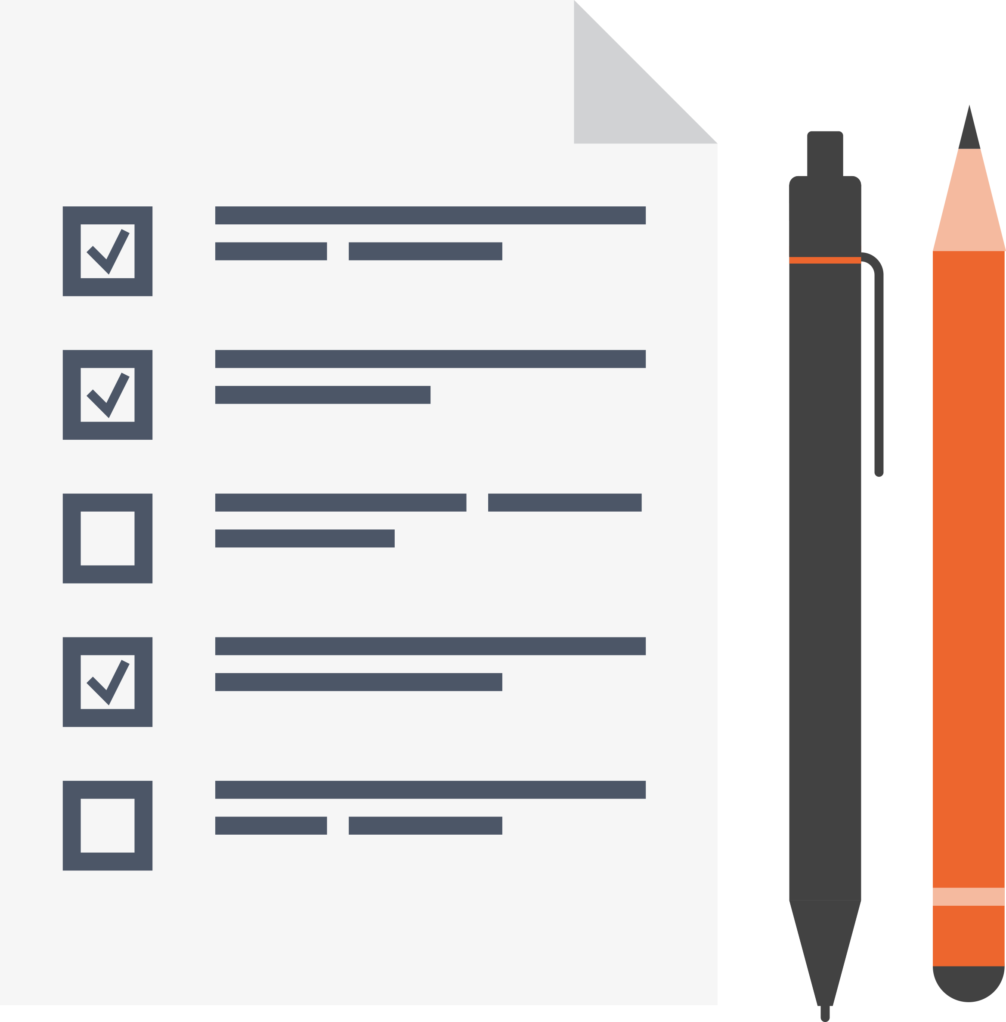
INVEST
Independent
Negotiable
Valuable
Estimateable
Sized Appropriately
Testable
Notes:
So how do we know if our story is ready to be worked on? Luckily there’s tool called “INVEST” which can help us get there.
Acronym captures 6 ideal qualities of stories
Independent
Can be worked on without needing to depend on other stories.
Stories can have prerequisites
But once the prereq is complete this story should be able to move on its own
No jumping back and forth between stories to finish a feature
Let’s us move a story around in the backlog without worrying about what needs to come with it
Negotiable
Room for devs to decide how to best approach
Avoid overly specific language or details
We can also see this come into play before the story is selected for the sprint
Fringe details can be split off and prioritized for later
Valuable
Not busy work
Makes a meaningful impact
Provides value to the customer
This may not be directly, for example, the story may be a technique pre-requisite for another customer facing story
But it should be obvious to us how this story helps us get there
Is the most important thing the team should be working on right now
Estimateable
Understood well enough that the team can give a reasonable estimate
Sized Appropriately
Big enough that it makes an impact
But not so big that it can’t be understood
As stories get bigger they become harder to understand and estimate
Prefer small stories
A story should be big enough that it makes a different…and no bigger
Testable
We understand how to check if we finished the story
The story is in a testable state
May need dummy data or scaffolding, that’s ok if that’s not the focus of the story
Remember, we’re testing the end result of the story….not the implementation

Slide 11

INVEST
Add the Ability for a Salesperson to Log into the Product
Independent
Negotiable
Valuable
Estimateable
Sized Appropriately
Testable
Let salespeople access the product
Notes:
This criteria seems a bit abstract when we just talk about it out of context, so lets look an example
Imagine a sales management application
The first story is to let salespeople access the product
Lets see how it does against INVEST
Independent?
No. How do they get accounts? Invited? Self-register?
Let’s assume they already have accounts. We’ll add stories later to let them be invited or register themselves.
(click to change story).
Now the story is more independent. Its smaller, and only focuses on a single, specific action of the login workflow
Negotiable?
Yes, we can negotiate types of login before we start
Password, social login, etc
And details of implementation after
How complex does the screen need to be? Just a login form, or additional info like recent news of the system
Valuable?
Yes, without it users can’t access the system
Most important thing we should do right now?
Yes
Estimateable?
Yes, its familiar…most devs have built a login screen
Smaller than it was previously.
Giving users access to the system wasn’t estimateable, asking us to create a password login screen is.
Sized appropriately?
Yes, once again because its smaller than it was previously.
This should be small enough a dev can “hold it in their head” at once
Testable?
Yes, there’s a clear end state. Either the user was able to log in or they didn’t
Remember that we didn’t handle how the user gets an account in the first place
This is an example where we’ll need to use dummy data, manually adding a user to our database first
That’s ok because its lets us test this story, and its not the point of this story
This story is now about how a user gets an account, only how they login after they have one
We’ll handle creating a user account in another story, and because we went through this process its highlighted that that’s something we didn’t consider
INVEST gives us a nice set of criteria to evaluate stories, but its not perfect
Some overlap – small stories tend to also be more estimateable and easier to test
That’s good, this creates a circle in which improving one aspect tends to improve others
A common theme is that many of these criteria can be improved by simply making the stories smaller
Not all attributes will apply to all stories though
Some stories so small they’re not negotiable
INVEST is a guide post…not a hard set of rules

Slide 12

Only apply INVEST to stories your team is almost ready to work on
Notes:
Now, applying this criteria to every story in your backlog may seem overwhelming at first
The good news it that you don’t have to.
Don’t apply INVEST to everything in the backlog
Just stories ready to go into the sprint
Don’t know enough about stories further down the backlog anyway
INVEST helps us tell stories that are ready to be worked on from those that aren’t

Slide 13





Backlogs Should be DEEP
Detailed Appropriately
Estimated
Emergent
Prioritized
Notes:
The list of stories our team is still slated to work on is called our “backlog”.
Most important stories are at the top
They will be worked on next
Stories become less urgent as you move down the backlog
Word “urgent” is intentional. Sometimes you want to avoid the word “important” with customers
Ordering the backlog like this lets us see which need to meet INVEST criteria and which don’t
Capture the qualities of a backlog as DEEP
We like our backlog to be
Detailed appropriately
Stories near the top should be well defined, or meet INVEST
Stories further down don’t need to be
Won’t be worked on soon
Actually want to leave lower stories undefined for now
May not ever be worked on, don’t waste time defining them
Don’t know enough about them yet…we’ll probably know more as they work their way up
Estimated
Each story needs to have a rough estimate…even those that aren’t well defined
Helps with prioritization as we can weigh the cost of each story against its benefits
We accept the estimates get less accurate as we walk down the backlog
Don’t worry, the team will get the chance to provide a better estimate if the story is selected
Emergent
The backlog will change over the course of a project
Some stories will change, be added, or be removed
Expect more churn near the bottom of the backlog
Another reason why we don’t define these stories well
Prioritized
Most important work at the top, less important at the bottom
Walk down the backlog and pretty the project was stopped. Would you be happy with what you shipped?
If not, then you need to reprioritize

Slide 14
Done Means “Done”
Notes:
We’ve talked a bit already about understanding what the goal of a story is, as well as knowing whether or not we actually hit it. So, how do we know when a story is complete?
Work with customer before starting
Define what the story looks like when done
Luckily our next practice takes care of this.

Slide 15
Done Means “Done”
What is the goal?
Corner cases or exceptions?
What will we NOT do?
Notes:
Some of the questions we need to ask are
What is the goal
What are we trying to accomplish?
What should the user be able to do when done?
Corner cases or exceptions?
Always corner cases
Can we think of them now
Handle them now, or later as a separate story
What will the story NOT do
This is important
Boundaries help the customer and dev team understand what we’re trying to do
And will it be enough
If not clear, both customer and dev team will make assumptions
When assumptions don’t agree we get into trouble
Agreeing on this ahead of time not only gives the team a clear goal to shoot for, but it also dramatically increases the chance that the customer will accept the story once it’s shown to them. We call this “Acceptance Criteria”. (click on “Acceptance Criteria”)

Slide 16

Acceptance Criteria helps us know when a story is finished
Notes:
Now, does this mean that we can never change our mind on a story? Not at all, agile is all about being adaptive to changing situations.
Stories more often rejected for misunderstanding than changed mind
Reduce the misunderstandings
We can focus on changing minds

Slide 17
Add the Ability for a Salesperson to Log into the Product
Redirected to dashboard after login
3 tries before account is locked
No password reset
Notes:
Acceptance criteria tends to emerge from conversations with the customer
Most won’t emerge until the story is the most defined, just before it gets worked on
Expect some to emerge over the course of development
This will make more sense if we see it in action so lets take an example
Salesperson logging in
Questions come up as we get ready to work on the story so we capture them as acceptance criteria
What happens after login
Helps establish our goal
What if the user misses their password? How many tries do they get?
This helps flesh out corner cases or exceptions
This means the user needs to be able to reset their password? Are we doing that as part of this story
This helps us define our boundaries.
A lot of these questions will come up during our planning meeting, when the team is trying to estimate the story
Often its not the goal that tells us how big a story is, it’s the details. That’s why we want to establish as many of those details as possible with acceptance criteria
Good acceptance criteria is Specific and easily measured
For each of these cases we it will be obvious whether or not we hit it

Slide 18


This story is done…
but it still needs to be tested.
Notes:
Defining how we know when a story is done doesn’t stop with the customer though.
How many times have you heard a developer say “this story is done…” (click)
“But it still needs to be tested”
Or, maybe
“testing the story”
“we just need to review it as a team”
“just need to add it the build script”
Whatever the reason, if a story is “all done except for…”, then its not really done.

Slide 19

Done Criteria
Unit tested
Peer reviewed
Added to deploy script
Notes:
Instead, we need to talk as a team and decide together what it means for a story to be done
Maybe that means that a story
Has unit tests
Has been peer reviewed
Has been deployed to a staging environment.
Whatever the criteria is that you pick, decide and agree on it as a team.
We call this “Done Criteria”
Keeps you honest as a team
Avoids stories that claim to be “done” but really aren’t
Choose criteria that represents past problems
Lots of duplicated code, use peer reviews
New changes often break old code, add unit tests

Slide 20
Keep It Together
Notes:
The final practice is to keep teams together once they’re formed
Teams for instantly
But take times to gel
Each time the team goes through same progress
Forming
Storming
Norming
Performing

Slide 21
Storming
Norming
Forming
Performing
Notes:
Let’s look at each stage
Forming
Teams start feeling each other out
People are polite, try not to upset
Storming
Gotten to know and trust each other
Gloves come off
Start to challenge each others opinion (good)
Conflict starts to arise (good or not)
Norming
Team starts to gel
Major disagreements resolved
People fall into normal routines
Performing
Team is on fire
Know how to work together and manage themselves
Has conflict, but productive conflict that solves problems
Few teams get here
But those that do are very productive
All teams go through this process, or at least as far as they get, but it can take a long time. The problem is that each time we change a team, we reset this process back to the beginning.
Teams vary how fast they go through this process, so be patient and give the team time to gel before deciding it isn’t working and breaking them up again.
Each time you break the team up you’ll have to start over.
It varies, but most teams can take any where between 2-4 sprints to really start to gel.
Give a team at least that much time before calling it quits.
(Tuckman’s stages of group development)

Slide 22
Notes:
As an example,
Joe, Steve, and Susan are all working well together.
Progressed through all four stages and are high performing
Then Michael joins
Only increased by one but now is a new team
Have to go through Forming, Storming, Norming, Performing process all over again
May be quicker, but will still take time
No guarantee the team will get back to Performing
Every time we change a team we interrupt it’s flow which is disruptive to the team’s productivity.
Instead, once we get our team the right size...leave it alone.

Slide 23
What Is the Right Size
7±2
Less than 5
Too small
More than 9
Too big
Notes:
So, this always begs the question “what is the right size for the team”.
Rule of thumb is 7+/-2…or between 5 and 9
Less than 5 – hard to get meaningful work done without outside help
More than 9 – Too big to self-manage
Team starts to step on each other’s toes
7+/-2 doesn’t just mean software engineers
Includes testers, designers…anyone who contributes
If on high side, hopefully team isn’t just engineers
Will be hard to keep 7 engineers busy without getting in each other’s way
If you have a choice, err on the side of smaller teams
Easier to self-manage
Can’t tackle as much work at once so
Planning becomes easier
Less likely to step on each other’s toes

Slide 24
Research at Harvard University has shown that the optimum size is five people.
Notes:
As a matter of fact, speaking of smaller teams
Most recent research says that 5 is actually ideal

Slide 25


Feed Them with Two Pizzas….
Notes:
Now, if you find all of the management theory on proper team size and makeup a little heavy…let me leave you with one last rule before we go.
Jeff Bezos (Amazon CEO) has two pizza rule
Any team that can’t be fed with two pizzas is too big and must be broken up
Although its less specific, this rule works well because
Easy to remember
More tangible
Another key difference though
No lower bound on teams
Only points to how big a team can get, doesn’t say how small it can be
Though we can infer that if two pizzas are too much for your team…maybe it should be bigger

Slide 26

Where to Go from Here
Get to INVEST
Define Acceptance Criteria
Choose Done Criteria
Keep Your Teams Together
Notes:
So, now that we know the practices we need…where do we go from here?
First, look at next stories be picked up
Does each meet INVEST
How do we get them there
Don’t have to do this for every story in backlog, just the ones next to be worked on
This is the single most important thing a scrum team can do to improve their productivity
Start with all stories ready to go, and be amazed at difference
Then, define each story’s acceptance criteria with the customer
What would it take to consider it done
May miss some things or things fall through cracks…that’s ok
Goal is to getting into the habit of starting each story thinking about its end game
And, sit down with team and talk about what it would take for you to consider it done
Unit tests, peer review?
Whatever it is, write it down, hang it up, and stick to it for all stories in sprint
Avoid formal document, hand write the criteria on a piece of paper
This reinforces to the team that we can change criteria if we find we missed something or if something isn’t working
After sprint is over
What was missing?
What wasn’t important
Use what you learned to keep refining your done criteria
Finally, keep teams together
Sometimes out of a dev team’s hands….but not always
Talk to your managers and discourage from rapidly reforming with the Forming/Storming/Norming example I mentioned today
If team does change
At least be aware of the phases you’ll go through each time
Use this new awareness to accelerate and get back to performing as soon as possible

Slide 27
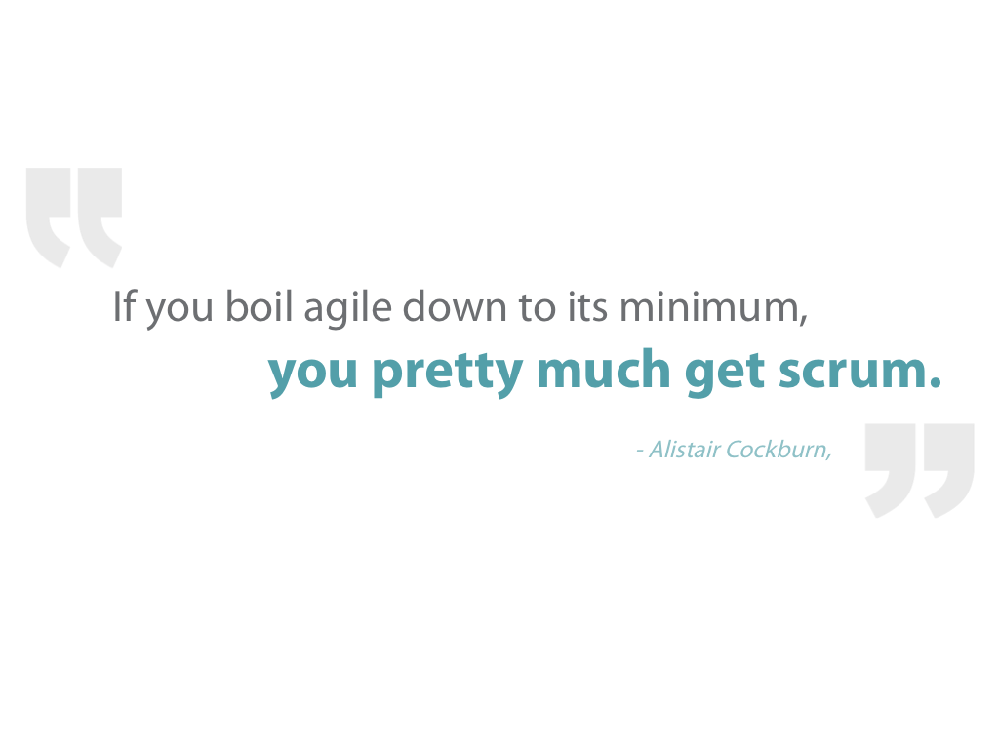
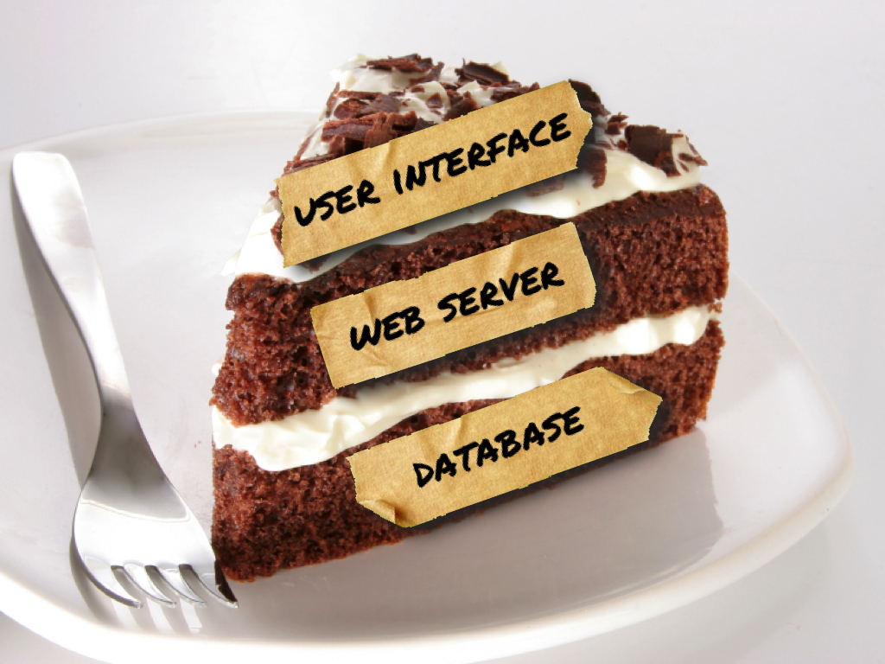
Learning More
Agile in the Real World course
Creating Effective User Stories course
Notes:
Hopefully this webinar will help you on your way to building a great agile team.
If you’d like to see more about how we can make agile really work on your team
such as dealing with disengaged or missing customers
making agile work with hard deadlines
or even scaling agile to multiple teams
check out my Agile in the Real World course where I break down the theory behind agile and explain what does work…and what doesn’t work in the real world.
I talked a lot about talking through things with your customer today to better understand stories. Unfortunately having a customer that’s always available isn’t a reality for many teams
One of the topics I talk about in this course is some ways that you can work around this or some alternatives you use, if you find yourself in a situation where you customer or
customer proxy isn’t as available as you’d like them to be
In addition, if you’d to learn how to write stories that let your team be productive as soon as they pick them up, check out my Creating Effective User Stories course.
In this course I show you
how big stories can best be broken down into smaller stories so your team can tackle them easier
or how to define clear acceptance criteria for a story so you’ll know what your customer wants before you start work on a story instead of after.
You’ve probably noticed one of the common themes is that simply splitting bigger stories into smaller stories has ability to make a lot of these problems much easier to overcome
But sometimes its not obvious how a bigger story can be broken down. In this course, I give you a lot of very specific and step-by-step techniques for breaking a large story down into a smaller story as well as figuring out which technique will work best for each of your stories.
Both courses are available from Pluralsight.

Slide 28
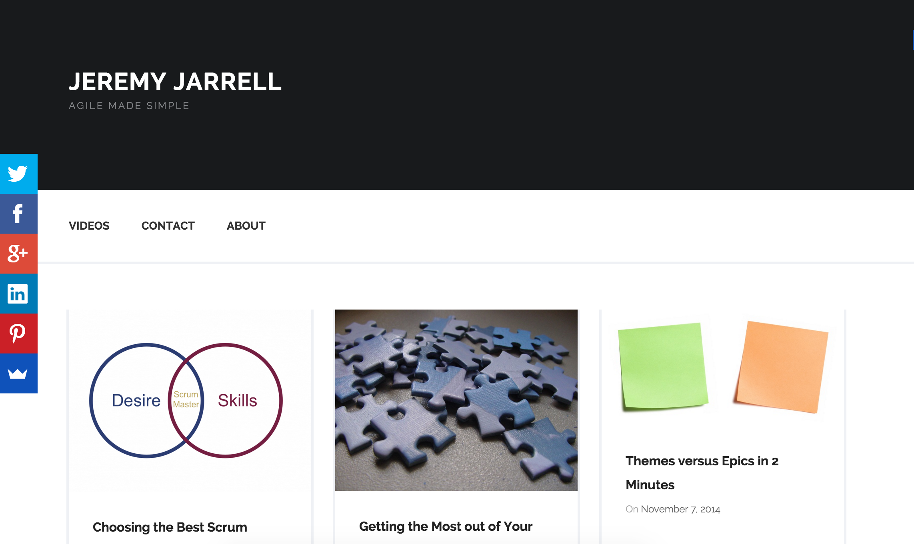

Getting in Touch
www.jeremyjarrell.com
@jeremyjarrell
Notes:
If you have questions about anything I’ve talked about today, anything in these course, or about agile in general, don’t hesitate to reach out to me through twitter at @jeremyjarrell.
In addition, you can always reach me at my website www.jeremyjarrell.com, This site also a lot of information about the problems that teams face when first implementing agile, and how to overcome them.
I’m happy to help you in any way that I can.

Slide 29
Notes:
Thank you all so much for taking the time to join me today, and thank you for Pluralsight for being gracious enough to host this webinar for us.
We still have some time left, so I’d love to open up the floor to any questions you may have.

